Slide 1
Payment Negotiations and Effective Telephone Handling for North and Mid Wales IRRV Association
Delivered
By
Darren Kelk MCICM IRRV

Slide 2
Introductions
Who am I?
Introduce yourself
How do you see the course helping you?
Key areas to focus on?

Slide 3
Why am I here – I hear you ask?
Improve collections
Improve knowledge – surrounding sectors as well
Confidence and more effective
Negotiate better
A day out of the office ☺

Slide 4
What I will Deliver!
Tips that will work if used
Gain confidence
Be more assertive and in control of the call
Learn to self critique your own calls
A refresher to your current knowledge
A fun environment
Stage by stage guide through – Guided Discovery

Slide 5
Team Task
What is the service you provide
What are key elements needed from the customer
What do you want out of the call

Slide 6
Open Session Call Structure
Identify the 3 main areas of the call structure
Identify and list 2 key areas in that call phase

Slide 7
Self Critique your calls
Good habits
Practice makes perfect
Start of Call
Voice is key
Alert – Responsive – Clear & Concise
Main Body
Develop the dialogue
Questioning
Security checks - DPA
Negotiations
Closure – Key to improved collections

Slide 8
My Attitude
My Behaviour
Their Attitude
Their Behaviour
Affects
Affects
Affects
Affects

Slide 9
Team Task
Incoming
Explain the challenges
Outgoing

Slide 10
Calls
A good Collector
Flexible
Inbound
Ambitious
Outbound
Knowledge

Slide 11
Project that Professional Image
Tone of voice
84% is how they will view YOU!
Tonality
Professional
Courteous
Smile
Match with body language
Image
Avoid jargon
Don’t patronise
Clear delivery
Plain Speaking

Slide 12
Key words and phrases
Important
Promise
Use the Tone to stress the point
Vital
NO!

Slide 13
Endeavour to make voice contact with the subjects to gain a commitment to pay
Role & Purpose
Subjects to meet their obligation to pay what they can afford
Understanding their financial situation
Encourage
Gaining information is key to making decisions
Gaining trust and getting the agreement for the subject to do something positive
Data

Slide 14
Qualities needed
Skills
Listening
Questioning
Communicational
Flexible
Organisational
Knowledge
Client Specific
Legislation
Compliance
Procedural
Attitude
Assertive
Positive
Determined
Empathetic
Reasonable

Slide 15
Recognise the ability or willingness of the customer to pay
Judge the economic appraisal of recovery
Commercial Judgement
Judge the condition of the financial circumstances
Full empowerment within the parameters that goes with the job

Slide 16
Recognising types of defaulters
Will Pay – But Don’t
Lazy
Forgetful
Grievances
Disorganised
Won’t Pay – But Could
Professional
Complainants
Know the system
Don’t care
Can’t Pay – But wish they could
Genuine
Hardship
Redundancy
Domestic crisis

Slide 17
Actions
Will Pay – But Don’t
Good collection practices
Slight pressure needed
Won’t Pay – But Could
Firm & assertive
No nonsense
Can’t Pay – But Wish They Could
Specialist collections
Hardship teams

Slide 18
A Customer or Debtor is vulnerable if for reasons of age, health, disability or severe financial insecurity they are unable to safeguard their personal welfare or the personal welfare of other members of the household

Slide 19
Do not ignore them
Signed authority to act for them
Dealing with 3rd parties
Negotiate with them
Take out of mainstream collections

Slide 21
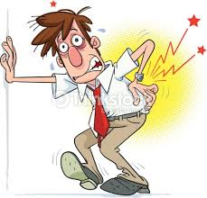
True
Reading off the internet
Avoidance – Delay tactic
Ask and probe
False
Question – be brave and get the detail
Surrounding knowledge

Slide 22
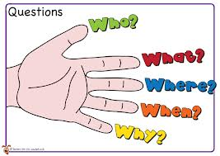

Slide 23
Open
Specific
Closed
Questioning Techniques
Leading
Hypothetical

Slide 24
Where?
How?
When?
Who?
Open Questions
Why?
What?
Encourage the subject to talk
Listen intensely
Build a picture

Slide 25
Did you?
Can you?
Have you?
Will you?
Closed Questions
Used to control the conversation
Generate Yes or N0!
Dealing with objections

Slide 26
What time do you get in?
Why will you not give me your mobile number?
When do you get paid?
Who was the person you talked with?
Specific Questions
Used to settle a point
Be direct
Deliver it with confidence

Slide 27
I can save you?
Do you want me to do that?
Would you be interested in?
This will affect you, are you sure you don’t care?
Leading Questions
Drive the subject to the answer you want
Make them agree with you
Play on desires
Lead them

Slide 28
Would you be willing?
I can save you?
If you had to?
Would you be interested in?
Hypothetical
Questions
If I know of a way?
Test the subjects reactions
Listen for the reaction in their voice
Buy in or buy out?

Slide 29
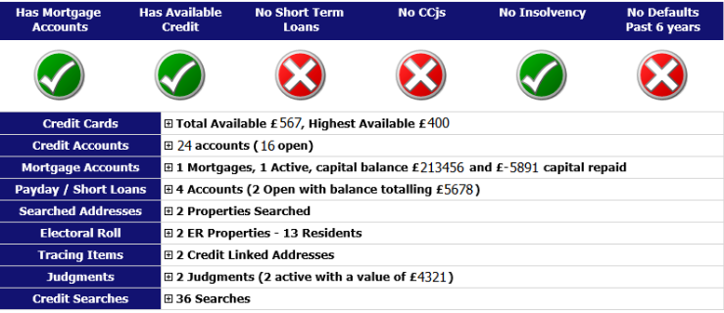
FI Data

Slide 30
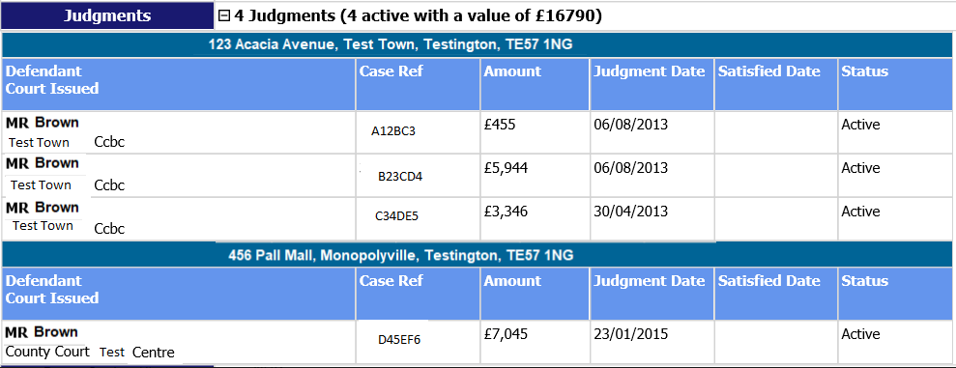

Slide 31
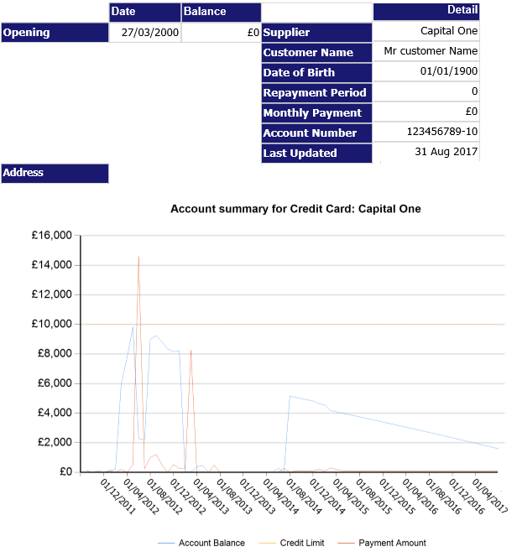

Slide 32
Negotiation Skills

Slide 33
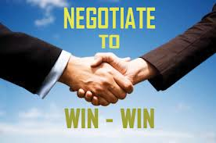
Negotiation
Questions
Skills
Information

Slide 34
Primary Objective – Full payment
NOW!
Secondary Objective – The best arrangement available
As much information as you can - employment
Prevent as many disputes as possible
Information to help with negotiations

Slide 35
Competitive
Motivated
Professional
Good listener
Tenacity
Flexible
Articulate
Confident
Discipline
Assertive
Skills
Empathy
Negotiation
The perfect negotiator

Slide 36
1st April 2014
OFT/FSA
All Lenders
New regulations
Strict code
DCA’s
Future lending
Priority debt
Consumer Credit

Slide 37
Impact
Lending
What Next?

Slide 38
YOU are a PRIORITY DEBT
These
Have
To Wait

Slide 39
Negotiation
Win - Win

Slide 41
Assertive or Aggressive
Its a fine line
What is assertiveness?

Slide 42
Not LESS important - that is SUBMISSIVENESS
Label given to a collection of behaviours that stem from a belief that YOUR needs or wants are AS important as other peoples
Not MORE important - that is AGGRESSIVENESS

Slide 43
Assertive
In Teams List Characteristics
Aggressive
Passive

Slide 44
Assertive – You MUST!
Key words & phrases
Listen
Learn to say NO!
Sell the benefits
Deliver the punishments
Win - Win
Assertive – You MUST Not!
Bully
Patronise
Be hostile
Show contempt
Be arrogant
Beat around the bush
Assertive you MUST Not!
Take the first offer
Back down easily
Never negotiate
Never ask questions
Roll over easily

Slide 45
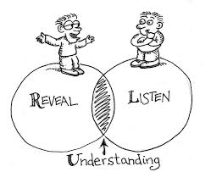

Slide 46
Decide what you want
Give and take compliments
Ask clearly for it
Assertive
Give and take fair criticism
Calm and relaxed
Decide if it’s fair
Don’t be afraid to take risks

Slide 47
Explanation
Needs
Consequences

Slide 48
Explanation
Explain the situation as you see it
Be as objective as possible
Keep to the point
Don’t theorize
Be brief
Needs
Be selective
One demand at a time
Be realistic
Be prepared to compromise
Consequences
Stress the rewards
Highlight the punishments
Work with us
Win - win
Assertive
Support what you say by HOW you deliver the message
Be clear and concise
Don’t get manipulated or sidetracked
Listening skill
SELL the benefits to the subject for a Win - WIn

Slide 49
Key words
I
You
No
Will
Debt
Need
Must
Important
File
Vital
Sentences
“Do YOU realise HOW Important this is?”
“Your FILE is going to the solicitor this afternoon”
“ I WILL ring YOU back at 11am tomorrow and YOU MUST be in to take the call”
“I NEED £100 today”

Slide 50
Team Task
Aggressive
List the type of person this is?
A person fiction or non fiction that fits?
Passive
List the type of person this is?
A person fiction or non fiction that fits?
Assertive
List the type of person this is?
A person fiction or non fiction that fits?

Slide 51
Listen and defuse the situation
Try not to put them on hold – keep talking to the subject
Don’t pre-judge the majority are genuine
Turn the call around
You are there to HELP

Slide 52
“Peter I hear where you are coming from”
Use the subjects name
“Appreciate your situation and so I am prepared to accept”
Offer options and alternatives
“Mr Brown we agree you are going to pay”
Check for agreement
Empathy
Not sympathy
Understand the problem
However – This is a debt and it needs paying

Slide 53
Keep calm and in control
Calm
Full notes on the system
System
Have a robust procedure in place
Procedure
Complaints
Reduced complaints – higher collections
There can be good complaints

Slide 54
Other Scenarios
You have to deal with them
Be professional
3rd parties
Backseat drivers
Angry
Upset
Confused
Chatterbox
Sarcasm

Slide 55
Adapting your style
Have to think on your feet
Each call and person a different from the last
Mistakes
Learn from them and move on
Everyone makes them – don’t beat yourself up!
Call centre robot
Monotone voice
No drive or ambition

Slide 56
Outgoing Call
Listen
Innovation
Make contact
Positive
Answer phones

Slide 58
Explain consequences - risks & rewards
Get them to write down details & read back – email communication
Stress the urgency - deadlines
Closure
Give impression dealing with a personal file
Ensure debtors knows how, when and where to pay
Confirm understanding
Personal
Conclude call with a summary and a promise
Remember “Win, Win”
Effective

Slide 59
Tone – Enthusiastic, remember it’s your “holiday money!” – 85% of the effectiveness of the call is down to your tone
It’s a “DEBT” not ‘Account’ or ‘Balance’
Negotiate from the top first on every call – Payment in full immediately!
Ask them to confirm mobile and line numbers even if it is on your system.
Use the debtors name throughout the whole call. I.E. Forename OR Surname.
You must get a PROMISE – get them to say “Yes”
Always go for ‘booster / lump sum’ payments
Always use “I” not ‘We’ to make it more personal
Always use ‘Tools’ to support your negotiation
Mark all postal payments e.g. cheques for your personal attention.
Can a relative or friend help you to pay this?
Incoming call – Once established it is the debtor – “Ok Mr/Mrs Jones, you are calling in to pay the debt in full today”

Slide 60
Give person the impression you are dealing with a physical file e.g. “I have your file on my desk” or “I need that payment on my desk, and I will have your file on my desk to check its here”
Use emphasis on words e.g. “This is VERY important!”, “This is VITAL!”
Be Assertive – say “No” to debtor proposals that don’t meet your agreement
Always get them to write down the main parts of the agreement and read it back to you
Always give deadlines for future payments, including a date and a time e.g. “I expect that payment to be on my desk by 12pm on Friday 13th June….”
Don’t put them on hold, get a number and call them back.
Use leading question to deliver tools e.g. “You could lose your home, surely you wouldn’t want that would you Mr Jones?” Do you want your employer to find out about this debt Mr Jones? If we go to court then we could request an attachment of earnings order. “If we go to court and get a CCJ then this will affect your credit rating, you don’t want that do you Mr Jones ?”
Remember – Persistency pays.

