Slide 1
IRRV Presentation
Mid / North Wales
27 April 2017
Anne-Marie Read, DWP Housing Delivery Division

Slide 2
Contents
Fraud & Error Incentive Scheme
Right Benefit Initiative 2017/18 (FERIS3)
Wider Use of Real Time Information (WURTI)
HB Debt & the Payment Deduction Project (PDP)
HB Fraud Referrals Process

Slide 3
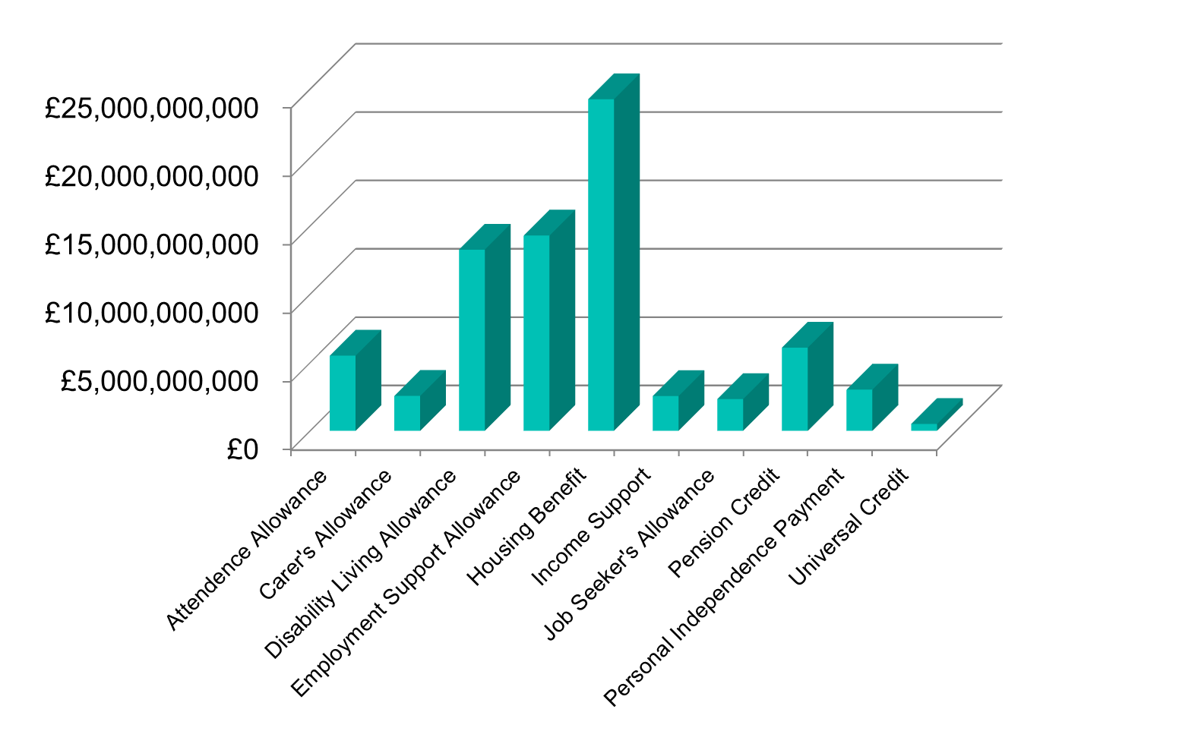
Context
Annual benefit expenditure 2015/16

Slide 4
Context
The Government paid out an estimated £24.2 billion in Housing Benefit (HB) in 2015/16
As at November 2016 there were 4.6 million recipients of HB, with the average award of HB being £95.92 per week. 1.4 million of those recipients came from the Private Rental Sector
Overpayments in HB identified through the Housing Benefit Review (HBR) process have increased to 6.0% (£1.46 billion) from 5.3% (£1.28 billion) in 2014/15
Tackling Fraud and Error in HB is fundamental to DWP’s overall strategy of reducing the amount of money lost to Fraud and Error
To help address the causes of HB Fraud and Error DWP launched the HB Fraud and Error Reduction Incentive Scheme (FERIS) in November 2014

Slide 5
Fraud & Error Incentive Scheme (FERIS)

Slide 6
Fraud & Error Reduction Incentive Scheme (FERIS)
FERIS 1
Total funding (including, start-up, bid fund, maintenance fund, incentive payments and end of year adjustments) paid out to LAs for the first year (2015/16) of FERIS amounted to £21.8 million (including £6 million in incentive payments)
The identification of HB overpayments has increased significantly since the introduction of FERIS
345 LAs demonstrated individual performance improvements and performed above baseline in one or more performance periods (over 91% of LA population) during FERIS 1
FERIS 1 activity delivered a return on investment of £2.36 for each £1 resulting in total Annually Managed Expenditure savings of £53 million

Slide 7
Fraud & Error Reduction Incentive Scheme (FERIS)
FERIS 2
FERIS design in 2016/17 was altered to take account of caseload changes (e.g. caseload changes due to Universal Credit (UC)). Baselines are now adjusted at the end of each quarterly performance period
In Quarter 1 we paid 183 LAs a total of £2.33 million in incentive payments (under FERIS 1 we would have paid 54 LAs £0.94 million)
In Quarter 2 we paid 115 LAs a total of £1.11million in incentive payments (under FERIS 1, 24 LAs would have received payments totalling £0.38 million)
Although the changes we introduced to FERIS 2 have had a significant impact on the value of incentive payments paid, actual performance is currently not meeting expectations with overall Quarter 2 performance only demonstrating a 0.2% improvement

Slide 8
Fraud & Error
To date, in spite of DWP / LA efforts and initiatives such as FERIS, HB Fraud and Error continues to be a significant challenge
Levels of Fraud & Error by Error Type for HB
 |  | 2011/12 |  | 2012/13 |  | 2013/14 |  | 2014/15 |  | 2015/16
Housing Benefits Total | Fraud | £350m | 1.5% | £320m | 1.3% | £430m | 1.8% | £590m | 2.4% | £1000m | 4.1%
 | Claimant Error | £650m | 2.8% | £780m | 3.3% | £900m | 3.7% | £550m | 2.3% | £380m | 1.6%
 | Official Error | £130m | 0.6% | £120m | 0.5% | £120m | 0.5% | £140m | 0.6% | £70m | 0.3%
 | Gross loss amount | £1,130m | 4.9% | £1,220m | 5.1% | £1,450m | 6.0% | £1,280m | 5.3% | £1,460m | 6.0%
*Net loss to government: removing recoveries from overpayments. Amount plus net loss as a % of expenditure.
Source of data: www.gov.uk – F&E in the benefit system -2015/16 data
We need to determine what the key factors are preventing LAs from making further reductions to HB Fraud and Error and understand how to overcome them
We need to establish what DWP can do to support LAs to achieve this

Slide 9
Right Benefit Initiative - 2017/18 (FERIS 3)

Slide 10
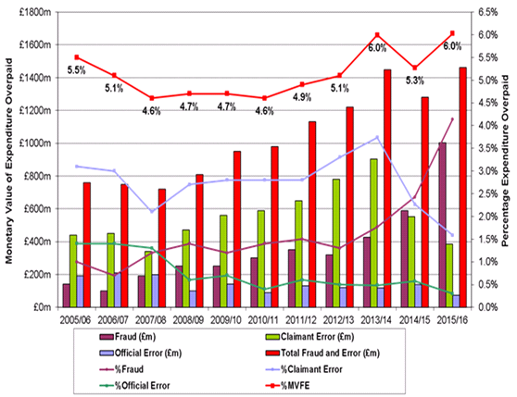
National Fraud and Error Statistics
Housing Benefit F&E has increased and show that earnings are the main source of loss.
Overpayments due to incorrect earnings in the in-work caseload accounted for around £560m in 2015/16 (40% of the total HB Monetary Value of Fraud and Error).

Slide 11
HB F&E in 2017/18
Targeting Right Benefit Funding to combat earnings F&E
Maximising WURTI data
Aligning Right Benefit funding more closely with WURTI
Simplifying the funding application process.

Slide 12
Wider Use of Real Time Information (WURTI)

Slide 13
Wider Use of Real Time Information (WURTI)
The WURTI Project has been working with six LAs since mid October 2016 to test the RTI service. The service will be deployed to LAs to assist them in tackling fraud and error in HB.
RTI provides access to HMRC earnings and non-state occupational or private pension information in real time through a digital web service, the RTI User Interface. The interface will be accessed through a desktop icon and HB staff will use the HMRC information to assess the customer’s entitlement and to confirm whether information provided by the claimant about their income is correct.
Additionally an alerts service will notify HB staff when the claimant and/or their partner’s income from employment or non-state pension changes.
The service enables LAs to prevent fraud and error entering the system from the outset at the new claim stage and throughout the duration of the claim through alert notifications.
The Project is consulting with the LA Associations Steering Group and Practitioners Operational Group and the Project’s plan is to start rolling out the service from April 2017. The Project will provide details of when roll out activities will take place for each LA along with guidance and relevant learning and development products.

Slide 14
WURTI HB Alerts Service
Currently developing a catalogue of business rules to trigger alerts
Start or end date reported for earnings and non-state pension
Flexible drawdown from pension, or payments with a pay frequency of irregular or one off. Include in test mid-October
Fluctuating earnings
works at payslip level
working with lawyers and analysts to agree a framework for using this functionality.
An evaluation will be completed after the 6 LAs have tested these alerts, and once we are in a position where the alerts solution provides an efficient way for LAs to prevent F&E on PAYE income the alerts will be issued to LA.

Slide 15
Housing Benefit Debt & the Payment Deduction Project (PDP)

Slide 16
Debt Recovery
One of the key challenges faced by both LAs and DWP is how HB overpayment recovery is managed in order to reduce outstanding debt levels
HB Subsidy arrangements reimburse LAs at a rate of 40p in the pound for HB fraud and claimant error overpayments. Failure to collect at least 60% of the debt represents a significant financial loss to your LA
HB Debt 2009 - 2016
HB Debt | Total Value of HB OPs Outstanding at the beginning of the financial year | Total value of HB Overpayments identified (April - March) £ | Total Value of HB Recoveries (April - March) £ | Total value of HB written off in year
2009/10 | 696,719,460 | 624,349,000 | 424,516,000 | 70,372,000
2010/11 | 821,045,020 | 672,145,000 | 436,188,000 | 63,984,000
2011/12 | 968,469,625 | 733,921,000 | 489,501,000 | 70,236,000
2012/13 | 1,126,643,625 | 765,663,000 | 513,539,000 | 75,459,000
2013/14 | 1,254,982,055 | 804,982,000 | 531,604,000 | 74,403,000
2014/15 | 1,362,261,000 | 983,792,000 | 588,893,000 | 93,950,000
2015/16 | 1,646,322,000 | 1,071,974,000 | 658,565,000 | 92,042,000
Source: HB Recoveries & Fraud data Sept 2016

Slide 17
Debt Recovery
Since FERIS and RTI were introduced in 2014 the amount of annual HB overpayments raised has increased by one third
In 2013/14 total outstanding HB debt at year end was £1,382 million. This increased by 13% to £1,566 million at the end of 2014/15 and by a further 26% to £1,977 million at the end of September 2016. A total increase of 43% in 2 years
In 2013/14 the annual value of identified HB overpayments was £805 million. This rose by 22% to £984 million in 2014/15 and rose by a further 9% to £1,072 million in 2015/16. An overall increase of £267 million on the annual figure
A careful and proactive debt management strategy is crucial, considering that the total value of outstanding HB overpayments continues to follow an increasing trend

Slide 18
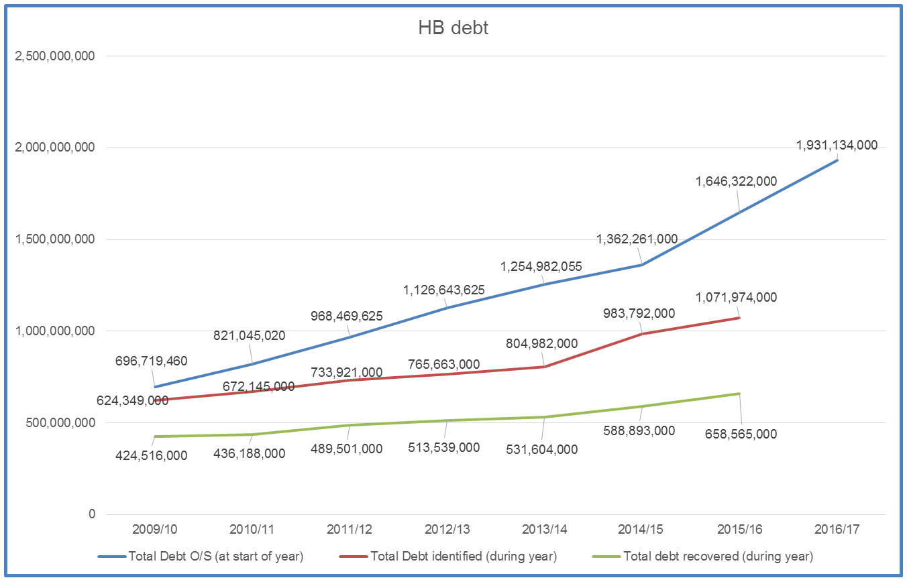
Debt Profile

Slide 19
Debt Recovery
High Performer
One LA who have performed well in debt recovery raised staff awareness of the impacts of the subsidy regime, reviewed their overpayment recovery policies and procedures and encouraged maximisation of recovery through existing channels such as Direct Earnings Attachments
This resulted in recovery of £1.23 million of HB overpayments in 2015, with a recovery rate more than 50% higher than the national average
That additional 50% equates to £540,000 in increased revenue for the council
Low Performer
Characteristics of an LA with lower performing debt recovery include a failure to regularly review recovery rates, failure to make best use of existing debt recovery channels and debts being recovered over unrealistic periods
One LA debt was being recovered at £1 per month, which would have taken 249 years to recoup!
HDD intend to write to those LAs that may benefit from some support in improving debt recovery performance

Slide 20
Payment Deduction Project (PDP)
The introduction of UC saw DWP review how they managed the continued recovery of outstanding LA HB debt (for cases no longer on HB)
UC and the Payments Deduction Project (PDP) have developed a digital system to ensure all HB debt can be referred for recovery from DWP benefits electronically (including potential recovery from DWP legacy benefits)
The interface allows the following data transfer functionality:
LAs are able to refer outstanding HB debt (Referrals)
LA notifications of revised debt balance can be sent to DWP Debt Management (Revisions)
the return of debts by Debt Management to LAs where appropriate (Cessations)
the recall of debts by the LAs (Recalls)
automated issue of the payment schedule of HB debt deductions to LAs

Slide 21
Payment Deduction Project (PDP)
The introduction of this digital interface replaced the previous manual process and while it is a positive step in supporting debt recovery, there have been some issues that DWP are working to overcome
In February 2017 a letter was issued to all Benefits and Revenues managers acknowledging issues including:
Non-genuine Revisions and the work being done with the relevant IT suppliers to review and resolve these
Revisions with mismatching reference numbers, the data cleanse work carried out, the guidance provided to all affected LAs
Reconciliation of the overall HB debt position and the engagement with POG to agree a way forward
Recall delays in the return of debts to LAs following a cessation request. Debt Management will provide further communication on this issue at a later date
Further communication will be shared as issue resolution is progressed

Slide 22
HB Fraud Referrals Process

Slide 23
Context
The Single Fraud Investigation Service (SFIS) Project brought together staff from DWP, LAs and HM Revenue and Customs (HMRC), enabling teams within DWP’s Fraud and Error Service (FES) to deliver a single fraud investigation across the full range of Welfare Benefits, including HB
The transfer of over 900 LA staff to DWP aimed to ensure that skills, expertise and knowledge were maintained and that a local presence continued to exist
Concerns were expressed by LAs about the new fraud process. Confidence in the new arrangements has been patchy, with referrals reducing by approximately 75% in some areas and stopping altogether in others.
This means that HB Fraud is not being properly tackled, and tax-payers’ money is not being protected.

Slide 24
Context
HDD undertook a sensitively handled independent review of the process, working with DWP Fraud & Error Service (FES) and LAs, and made 35 recommendations. All have been accepted and most have already been implemented.
So some progress has been made, but there is still significant evidence that processes are not yet fully effective.

Slide 25
Changes Implemented
Central Referral Service (formerly Referral Enhancement Service)
A large number of the recommendations suggested improvements to this service.
By July 2016, CRS had:
Centralised all HB fraud referrals. They now go directly to the team in Taunton and are fast-tracked from there into FES Local Service.
Up-skilled the team at Taunton with HB and SHBE data training and produced supporting guidance, including ‘What makes a good referral’ for LAs to use.
Removed the backlog of work.
Introduced an auto-acknowledgement to LAs on receipt of a referral. CRS are currently taking steps to further improve this function.
Collaborative working
All FES Group managers have agreed, as of July 2016, to ensure their teams are working collaboratively with local LAs. We obviously hope that LA counterparts will reciprocate this approach. Good liaison is absolutely critical to ensure that local issues are resolved through local discussion.

Slide 26
Local Service
Following discussion with a number of LA colleagues, HDD proposed a number of changes around the HB fraud referral process. These proposals were agreed by DWP FES Senior Leaders and approved by POG on 29 November. The changes approved are:
Local Authority Information Exchange Form (LAIEF)
The LAIEF form itself has been revised and improved following feedback that it adds little value in many cases. The form is much more user friendly and intuitive. It also now includes more space for FES to provide full details of the action taken on a case.
The use of the LAIEF has been rationalised:
A new accepted/rejected box has been introduced with an explanation box
In low level fraud cases the LAIEF will be for information purposes only for the majority of cases.
Part 2 will only be completed if FES need to request further information, which will be in the minority of cases.
FES guidance and communications will be updated to reflect agreed changes.

Slide 27
Low level fraud process
One of the main issues facing LAs was that LAs were making referrals but never hearing anything about the referral again. This was because the process for dealing with HB referrals in FES Low level fraud was unclear.
As of 9 January 2017, this process has now been clarified and action is starting to be taken on these cases. You should have seen these cases being returned to you with full details of the action taken by FES.
Fail to attend cases
Previously, if a customer failed to attend a Low level fraud interview the case was closed by FES and returned to the LA for further action. LAs would often suspend benefit in these cases.
This process has been changed to allow the case to remain open for a calendar month to enable the customer’s interview to be re-booked immediately they make contact, rather than the onus for further action resting with the LA (as frequently happens now).

Slide 28
Communications to LAs & Next Steps
These changes were communicated to you in circular F1/2017 (w/c 20 February 2017) and we also held a conference call to highlight all the improvements made and give LAs the opportunity to raise questions - 400 people dialled in.
We are currently embarking on an evaluation exercise of the changes that have been made to the process. We are going to conduct this evidenced based review through a series of HB fraud health checks.
SLA – agreement has been reached in FES to amend the timescales for action noted in the current SLA between individual LAs and their FES counterparts. The SLA is being re-drafted to better reflect achievable timescales in the light of new processes.
MI – work is continuing to develop a suite of MI that will support the new arrangements. We expect to have this ready for discussion very soon.

Slide 29
Summary
HDD have listened to the concerns voiced by Local Authorities about the impact of the new HB fraud processes.
We have, with DWP FES, and with valuable input from several LA representatives, identified a large number of improvements.
We ask that LAs continue to work with us while these changes bed in over time.
We are confident that, with your support, we will soon have a process that is robust and supports our collective efforts to bear down on HB fraud.

