Slide 1
Business Rates Revaluation 2017
[Liz Thomas BSc (Hons) MRICS
Rating Team Leader Appeals, Wales
4 November 2016
www.gov.uk/voa/revaluation

Slide 2
What we’re going to look at today

Slide 3
Revaluation 2017

Slide 4
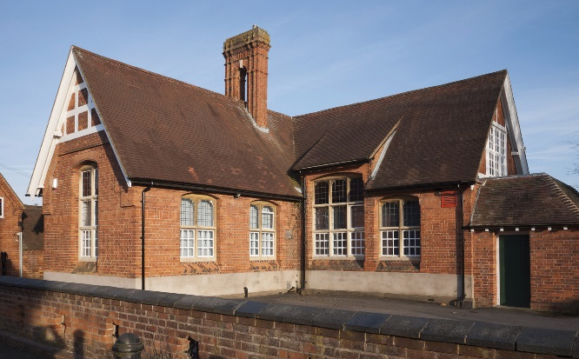
Valuation schemes

Slide 5
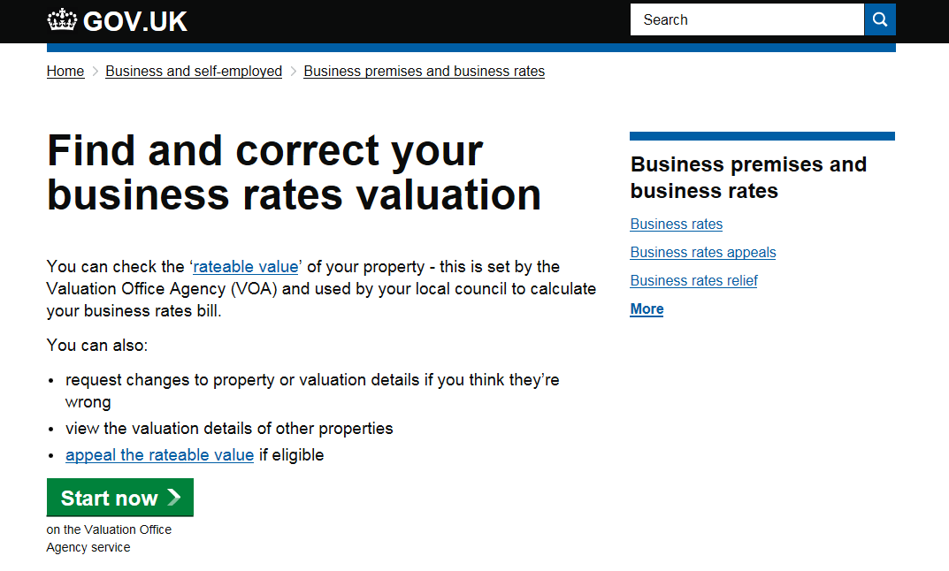
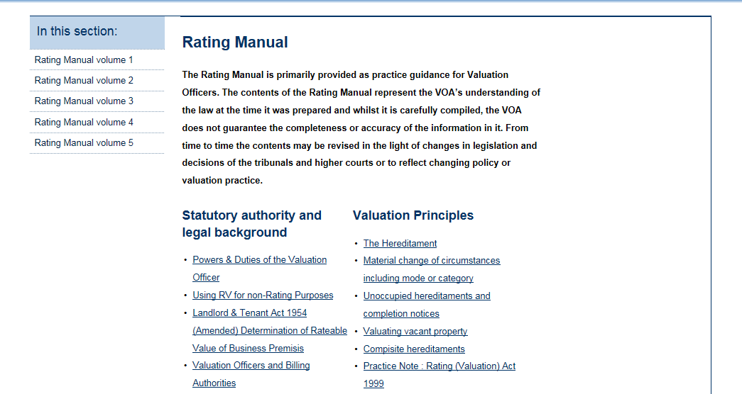
We publish information to support our valuations

Slide 6
Revaluation 2017- Outcomes

Slide 7
Revaluation – national change in overall rateable value
England
 | Assesments | Total 2010 RV (£ billions) | Total 2017 RV (£ billions) | RV Change (%)
Local Lists | 1,856,450 | 57.69 | 63.21 | 9.6%
Central List | - | 2.72 | 3.83 | 40.6%
England (Total) |  | 60.41 | 67.04 | 11.0%
Wales
 | Assesments | Total 2010 RV (£ billions) | Total 2017 RV (£ billions) | RV Change (%)
Local Lists | 112,090 | 2.46 | 2.39 | - 2.9%
Central List | - | 0.16 | 0.21 | 25.8%
Wales (Total) |  | 2.62 | 2.59 | - 1.1%

Slide 8
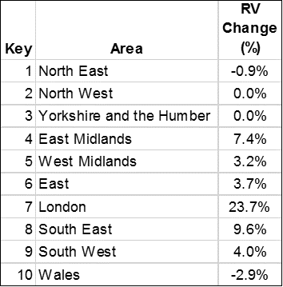
Percentage Change in Rateable Value (Local Lists)

Slide 9
Percentage change in rateable value split by Region and Sector
Area | Retail | Industrial | Office | Other | Total
ENGLAND | 4.8% | 4.0% | 12.7% | 15.9% | 9.6%
NORTH EAST | -6.5% | -0.4% | -12.3% | 9.5% | -0.9%
NORTH WEST | -5.4% | -3.5% | -4.4% | 10.7% | 0.0%
YORKSHIRE AND THE HUMBER | -1.9% | 0.7% | -12.4% | 7.1% | 0.0%
EAST MIDLANDS | 5.6% | 3.3% | 8.2% | 13.4% | 7.4%
WEST MIDLANDS | -0.9% | 3.4% | -6.8% | 12.3% | 3.2%
EAST | -3.6% | 2.3% | 2.4% | 12.3% | 3.7%
LONDON | 26.8% | 15.5% | 22.6% | 26.1% | 23.7%
SOUTH EAST | 1.2% | 6.7% | 12.9% | 17.8% | 9.6%
SOUTH WEST | -5.7% | 5.4% | -0.4% | 13.9% | 4.0%
WALES | -8.5% | -4.0% | -6.6% | 4.5% | -2.9%
Source: VOA Administrative Data as at 25 September 2016

Slide 10
General trends in different sectors

Slide 11
Check, Challenge, Appeal
What we know at present…
https://www.gov.uk/government/consultations/reforming-business-rates-appeals-check-challenge-appeal

Slide 12
www.gov.uk / voa / revaluation
@VOAgovuk

