Slide 1
Welfare Reform Time for a Reality Check
David Magor OBE IRRV (Hons)
Chief Executive
Institute of Revenues Rating and Valuation

Slide 2
To Remind You
The deficit has been delegated to the poor
The pain is not over
The Autumn Statement was disastrous for those in poverty
The welfare reform propaganda continues
The wider economic situation is not helping
The accelerated rollout of UC is a myth
In Scotland, the Smith Commission has put another nail in the coffin of UC

Slide 3
Is it Fair?
Since 2010 pensions have grown by 11%
But the annual up rating of most other benefits have been restricted to 1% for the last three years
Now those benefits will be frozen
The cap will be further reduced
The manipulation of the minimum wage will reduce tax credits.

Slide 4
It is not Just Welfare Reform!
The lack of growth
Inflation leading possibly to deflation
Cost of living
Income and wages
Minimum wage against the living wage
Real jobs!
Cost of fringe borrowing
Family and social pressures

Slide 5
To remind you!

Slide 6
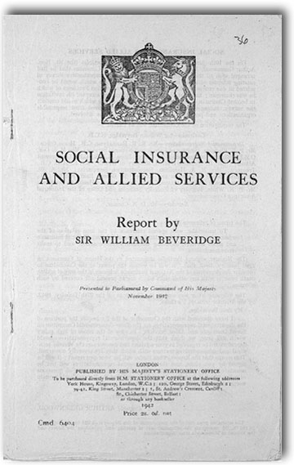
The Most Significant Reform of Social Security in 60 Years
Notes:
6

Slide 7
Current system
New system
Income related JSA
Income related ESA
Income Support (including SMI)
Working Tax Credits
Child Tax Credits
Housing Benefit
Universal Credit
Disability Living allowance
Personal Independence Payment
Pension credit
… will include support for housing and children
Child Benefit, Carer’s Allowance (will remain)
Council Tax Reduction and Rate Support
Contributory JSA and ESA

Slide 8
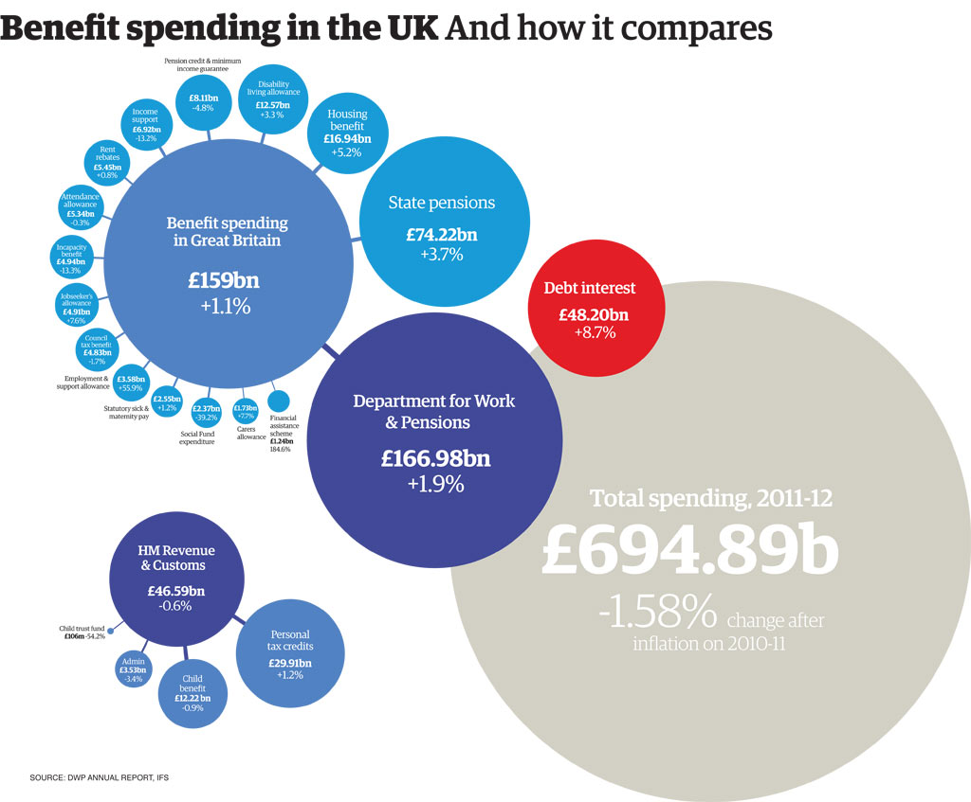

Slide 9
What of Universal Credit
Universal Credit migration
The IFS Report
The latest NAO Report
Current policy of claimant cleansing
More transparency rather than political spin
Clarity on the role of local authorities and who will pay
The housing element and housing benefit.

Slide 10
Universal Credit Migration
The latest information from the DWP shows that existing benefit claims will start to be transferred to UC and the ‘legacy benefit’ (including HB) closed, from Autumn 2016 but new legacy benefit claims will still be being taken during 2017.
‘Universal Credit at Work’, stated the timescale for roll-out projects there will be
100,000 recipients of UC by May 2015,
500,000 recipients by May 2016, and
7.7 million recipients by the time roll out is complete.
When asked if the 7.7 million claimants would be transferred by 2017, Mr Duncan Smith replied - 'That's our belief at the moment under the system that we are running’ – but 'Arbitrary dates and deadlines are the enemy of secure delivery.'
The Minister for Disabled People, Mark Harper, confirmed that the last new claims for legacy benefits will be accepted in 2017, following which, ‘the stock of remaining legacy claims will progressively decline’, but added that under ‘the current business case’ the DWP expects to migrate ‘the bulk’ of legacy benefit claims onto universal credit by 2019.
He added the rider that this latest timescale was based on the assumption there was no change in the labour market outlook or the pace at which claims are migrated.

Slide 11
IDS Reveals the Number of UC Claimants in the West of England

Slide 12
Myth – There is a plan
Reality
Structured chaos
Avoiding the problems
A new meaning for acceleration
Built around spin and political expediency
Is Job Centre Plus fit for purpose?
Universal Support, Triage, what’s your plan?

Slide 13
Accelerated Rollout of UC
The proposal is that all Jobcentre plus offices in the NW England will be taking UC claims before the rest of the United Kingdom
Around 100 jobcentres in the NW England should be taking UC claims by the January 2015. They will also be the first areas to have the roll out extended to childless couples then families.
The national roll out, although now starting in Feb 2015, will only initially affect new claims from single persons and will not apply immediately to all single claimants across the country
There are 73 local authorities in the “first tranche” , and
58 local authorities in the second tranche
Roll out in individual areas will be subject to discussions between LAs and their local Job centre plus district managers.
Much of the timetable will be dictated by local jobcentre preparedness and IT availability.

Slide 14
The IFS Report
More than half of social security spending goes to pensioners, and their share of total spending has been rising in recent years
Support specifically for families with children is now mostly delivered through the tax credit system
Real-terms tax credit spending more than quadrupled between 1997/1978 and 2010/2011, from £7bn a year to over £30bn billion a year
Over two-thirds of the real-terms increase in spending directed at the whole non-pensioner population over this period;
Real-terms spending on housing benefit has almost doubled over the last two decades, reflecting
Rising private rents and
The growth of the private rented sector
Reductions in other government subsidies for housing;

Slide 15
The Latest NAO Report
Facts
17,850 claimants on Universal Credit at the end of October 2014
500,000 to be on by April 2016, and
7,000,000 by December 2019
Report has fifteen findings, and
Three recommendations
Ensure the test and learn approach has a clear basis for making decisions across the strands of the programme
Develop specific milestones for both digital and live services before each additional stage of rollout
Set out more clearly how and at what point live service and other test and learn activities will inform the development of UC

Slide 16
Myth – Localisation is the proven answer
Reality
What about Wales, Scotland and Northern Ireland
Are the pilots and projects good evidence
Are local authorities signed up to Universal support
Is the Third Sector on side
Is the funding in place
How is discretion managed in a localised environment
Where does the Work Programme fit in

Slide 17
Support for Social Landlords
To address the concerns of social landlords over the impact on rent arrears of UC direct payment, the DWP has announced that that UC claimants who fail to pay their rent could have up to 20 per cent of their standard allowance deducted to meet the arrears.
The details are included in a 'support pack' for social landlords
the amount that can be deducted from a claimant’s UC if they fail to pay their rent has been increased from 5% to up to 20% of the UC standard allowance with a minimum deduction of 10%.
Introducing the support pack which 'has been designed to give social landlords practical advice on how to ensure their tenants are prepared for universal credit', Minister for Welfare Reform Lord Freud said -
“Social landlords have been playing a vital role in welfare reform and supporting tenants who are already receiving universal credit. UC will be in almost 100 Jobcentres by Christmas, with national roll-out beginning early next year – so now is the ideal time to boost preparation activity.”

Slide 18
Myth – there is a system
Reality
Where is the specification
Can I see the project plan
There must be a delivery model
Can we see the test system
Why don’t you talk to the three local government software houses
Housing element, how is it going to work
Integration?
Interfaces?

Slide 19
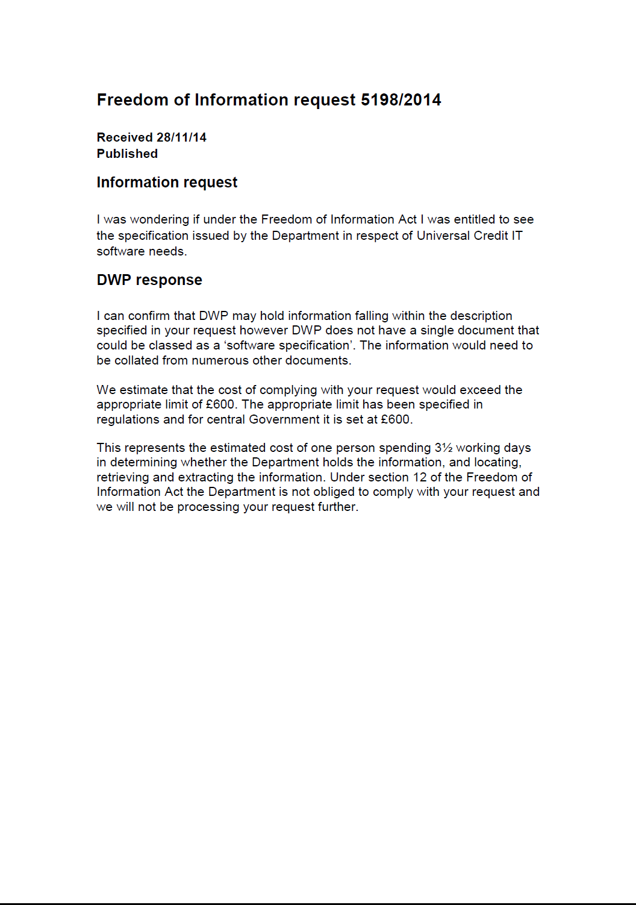
The System

Slide 20
Housing Benefit Turning Back the Clock
1972 through to 1982 then the world changed
HB82(2)
The partial start and full start over 6 months
A warning from history
September 1982 in Oxford Operation Major
The real reason for change was revealed
What will prevent this happening again?.

Slide 21
Myth – Housing Benefit Expenditure is out of control
Reality from the IFS
Case load is growing because more people are being forced into the private rented sector because they can’t afford to buy
The private rented sector evidence of rents passing is increasing significantly
Social sector rents are increasing because of reduced subsidy

Slide 22
Council Tax Reduction in England
2013/14, year one was tough
2014/15, year two was tougher
2015/16, year three will be even tougher
Funding parameters changing
Separate funding identity being removed
Rolled into the annual financial settlement
Continued emphasis on the working aged
How will local authorities react?
How will the Government respond?
Decisions in the courts.
2016/17, year four could be a disaster

Slide 23
Myth – Welfare payments to non UK citizens is out of control and growing
Reality
The international facts tell a different story
In Germany the number of Britons claiming unemployment benefits is four times that of jobless Germans claiming similar benefits in the UK
In Ireland the ratio is five times
In nine other western European Countries including France there are 23,000 UK claimants which is three times higher than the equivalent claims in the UK from those countries
BUT
In the UK there are 14,880 Poles claiming JSA against two Britons claiming equivalent benefits in Poland!
From certain other former Eastern European countries (Slovakia, Latvia, Hungary, Lithuania and Romania) there are 17,600 JSA claimants against fifteen Britons claiming equivalent benefits in their countries

Slide 24
In Conclusion
Still no light at the end of the tunnel
The Government is attacking those least able to cope and this will continue
An unfair emphasis on the working age and the young
General pressure on those in poverty
Too generous to those of pensionable age
We are facing an administrative disaster
There is no easy solution.

